Slide 1
All That Glitters: The Effect of Attention and News on the Buying Behavior of Individual and Institutional Investors
Brad M. Barber & Terrance Odean
BCG lab seminar Apr 30th, 2021

Slide 3
Overview
This paper shows that individual investors are net buyers of attention-grabbing stocks, e.g., stocks experiencing high abnormal trading volume, stocks with extreme one-day returns, and stocks in the news.
Attention-driven buying results from the difficulty that investors have searching the thousands of stocks they can potentially buy
Individual investors do not face the same search problem when selling because they tend to sell only stocks they already own.
1
2
3

Slide 4
Data
A large discount brokerage – trading and position records for the investments of 78,000 households from Jan 1991 to Dec 1996
A small discount brokerage – ‘’ from Jan 1996 to June 1999
A large full-service brokerage – ‘’ from June 1999 to Jan 2002
Plexus Group- a consulting firm that tracks the trading of professional money managers for institutional clients from Jan 1993 to Mar 1996
1
2
3
4

Slide 5
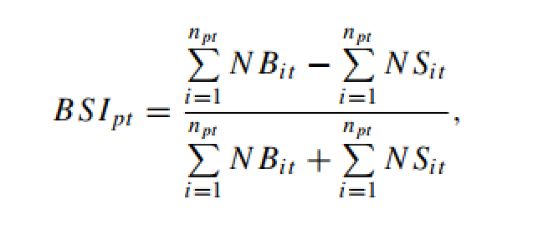
Main Variable – Buy-Sell Imbalance

Slide 6
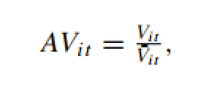
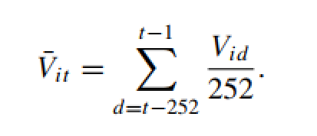
1.1 Volume sorts

Slide 7
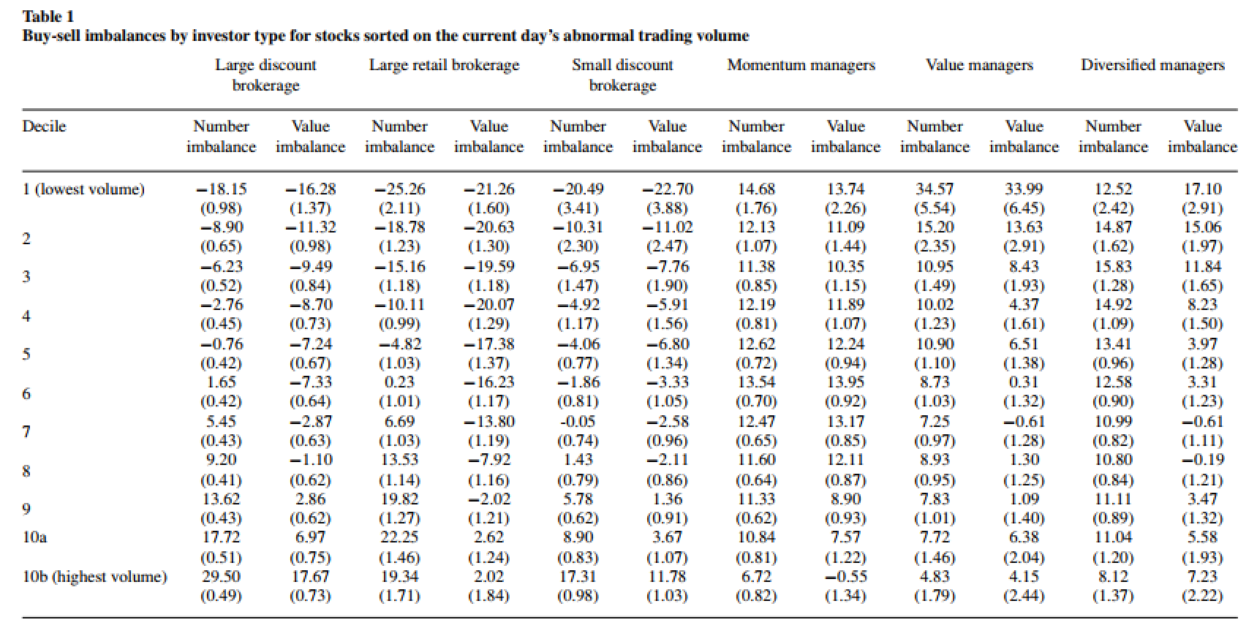
1.1 Volume sorts

Slide 8
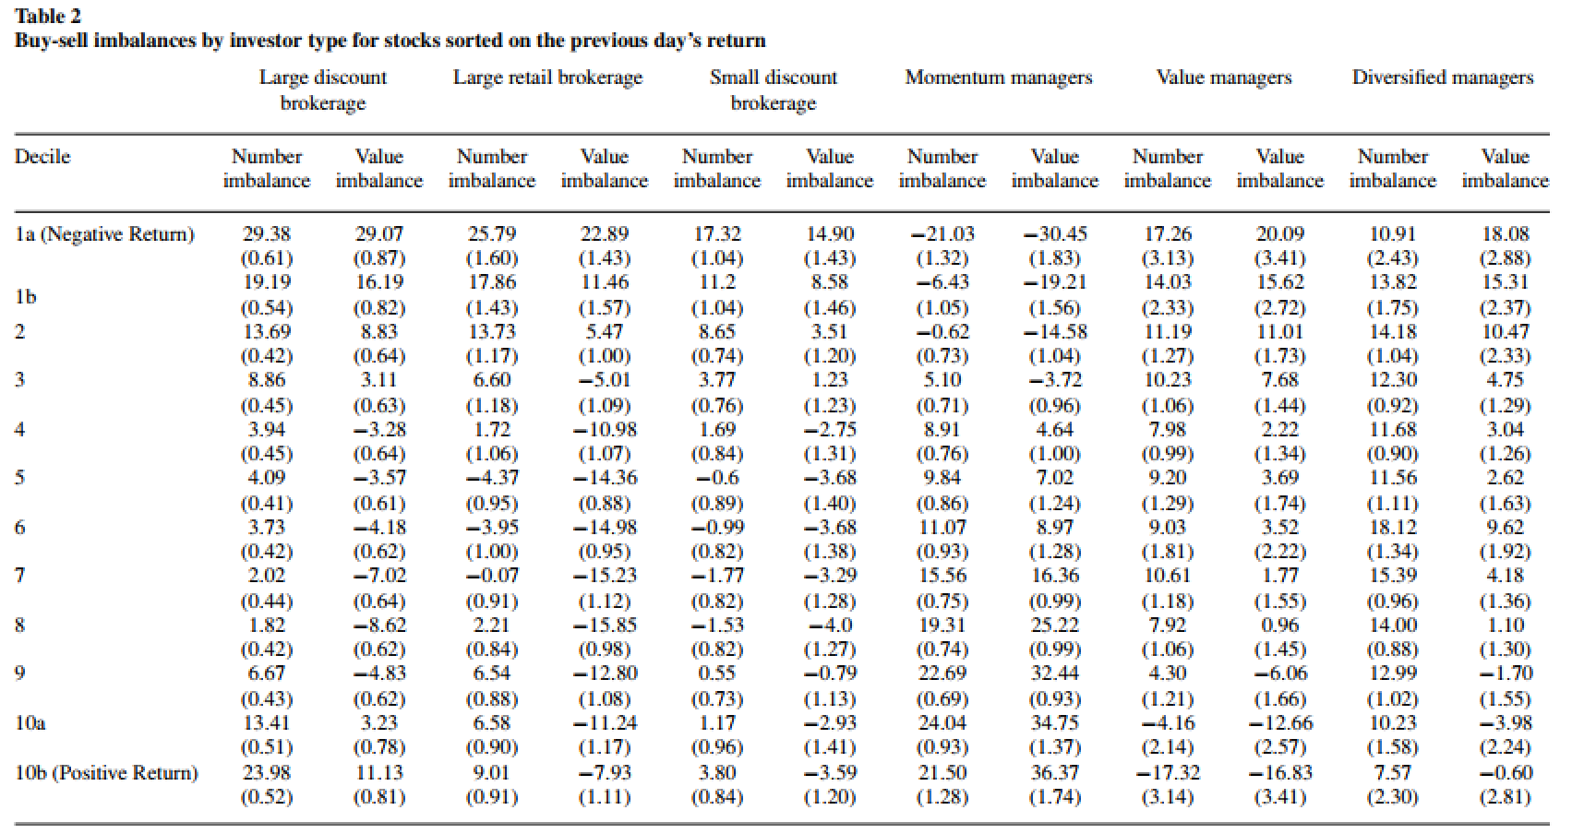
1.2 Return sorts

Slide 9
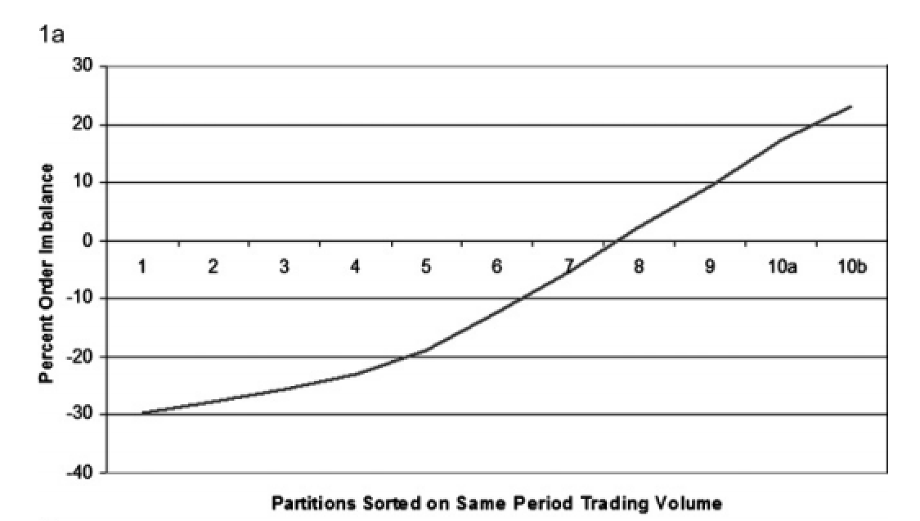
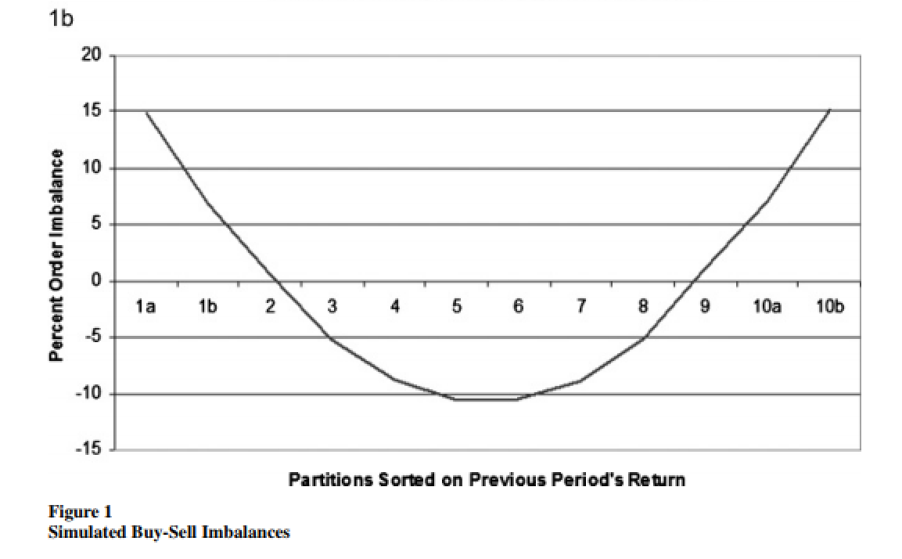
Fig 1. Simulation by Kyle (1985)’s model

Slide 10
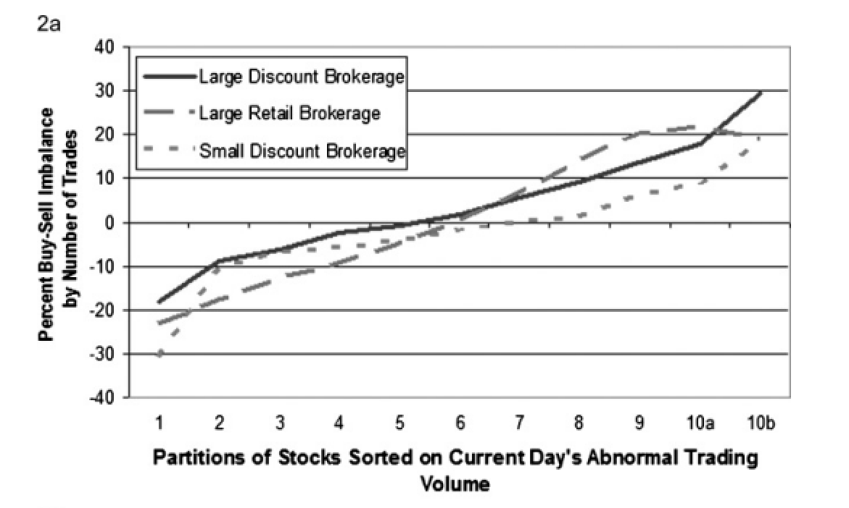
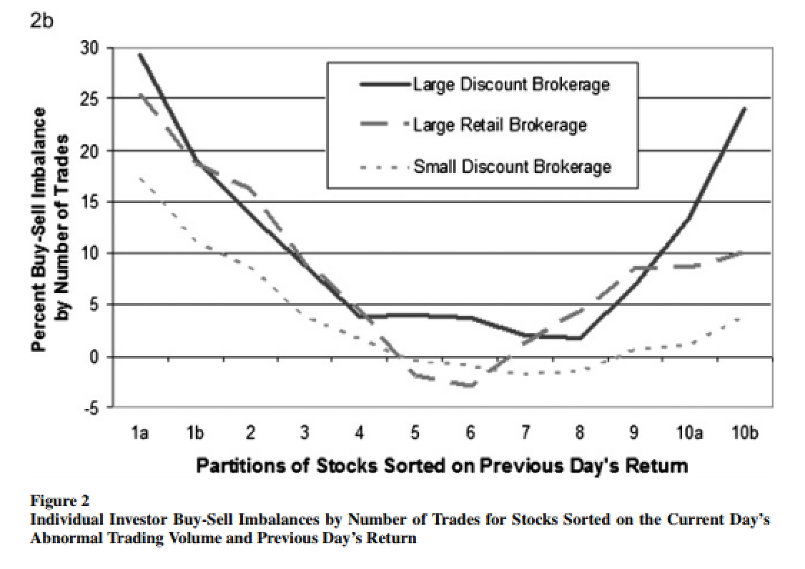
Fig 2. Buy-Sell Imbalances of actual data

Slide 11
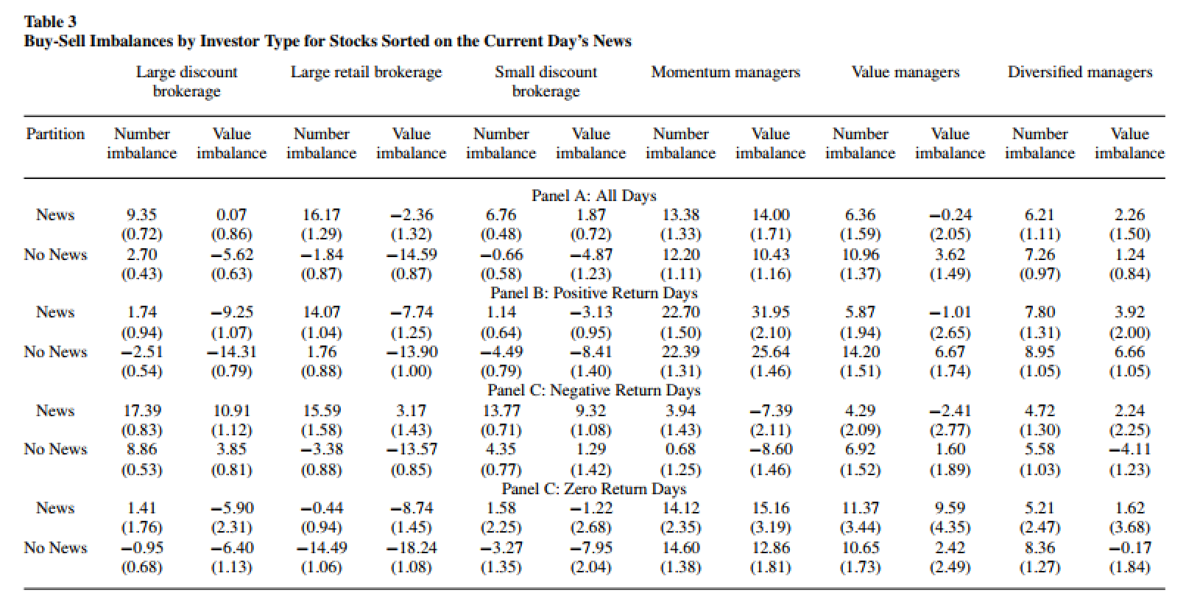
1.3 News sorts

Slide 12
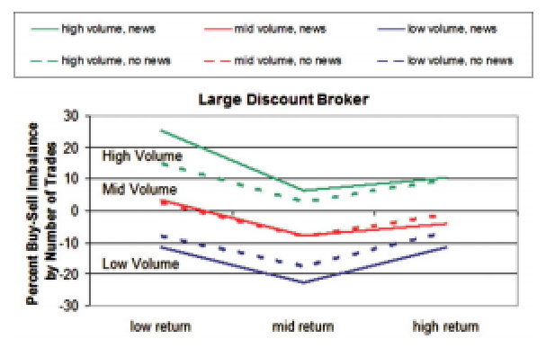
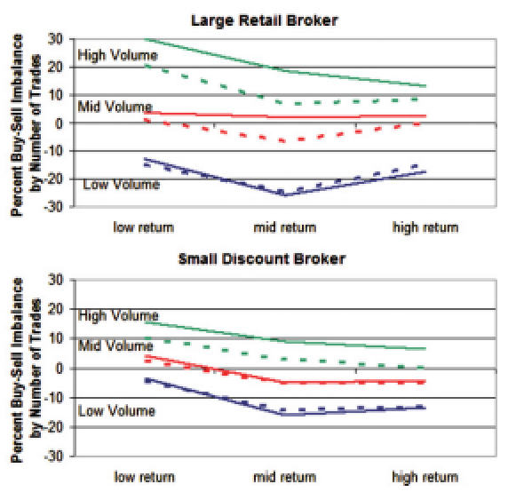
Fig.3 Buy-Sell Imbalances sorted by them all

Slide 13
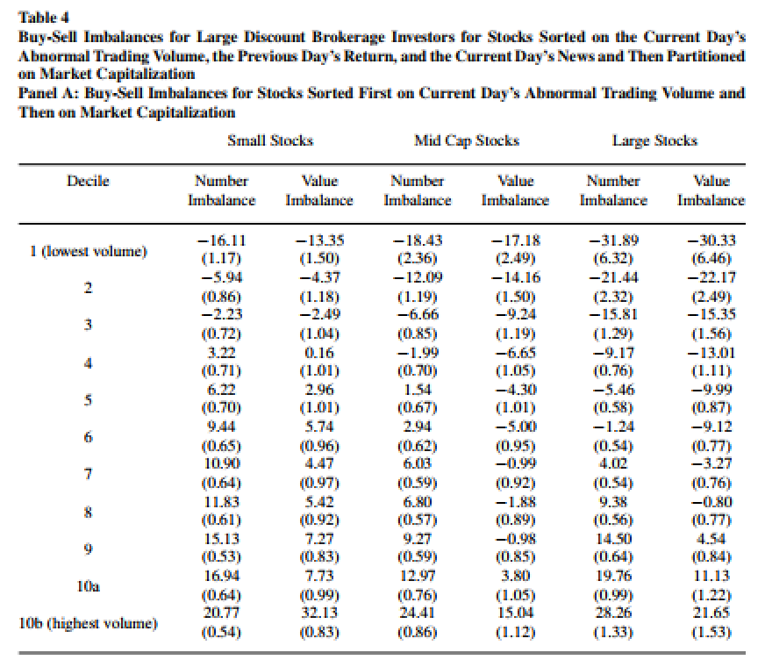
1.4 Size partitions (by market capitalization)

Slide 14
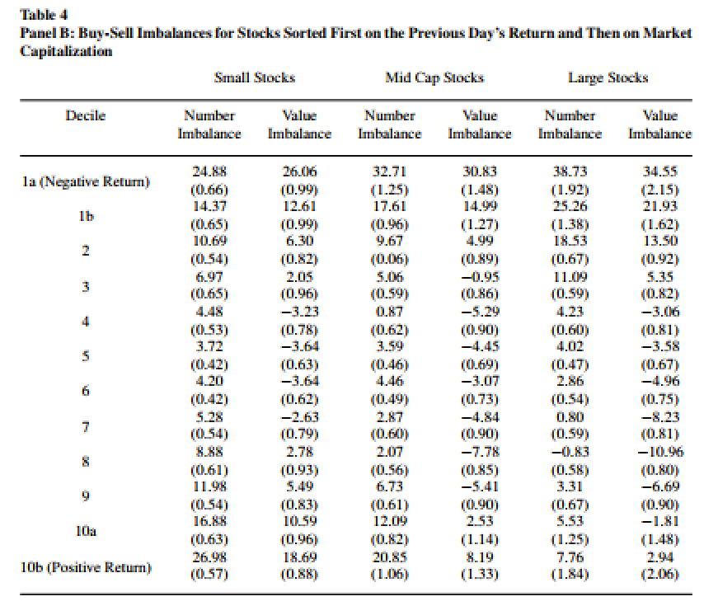
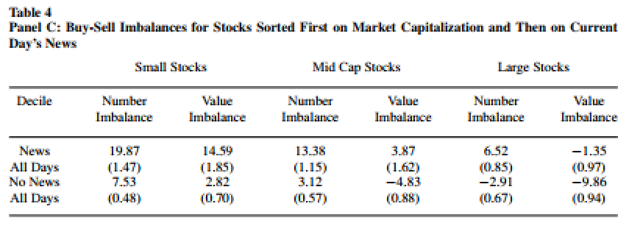
1.4 Size partitions (by market capitalization)

Slide 15
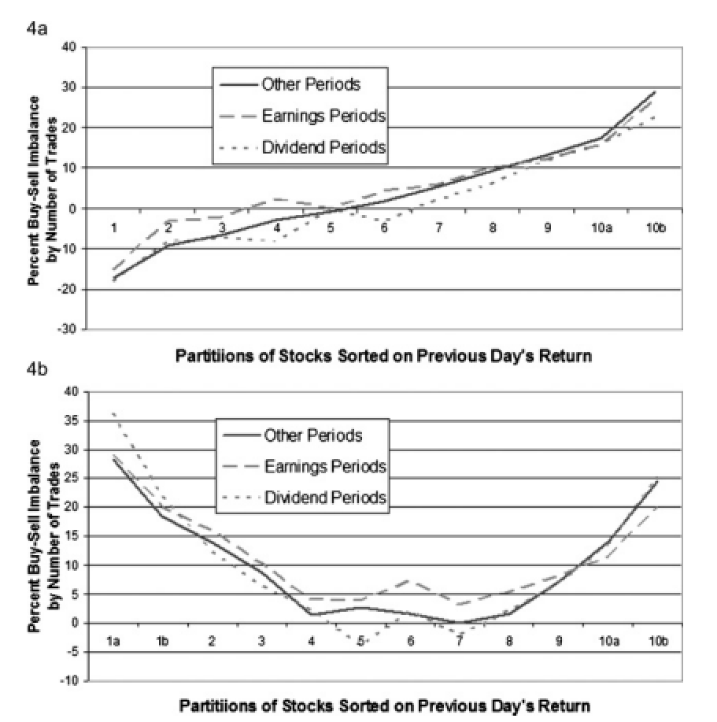
1.5 Earnings and dividend announcements

Slide 16
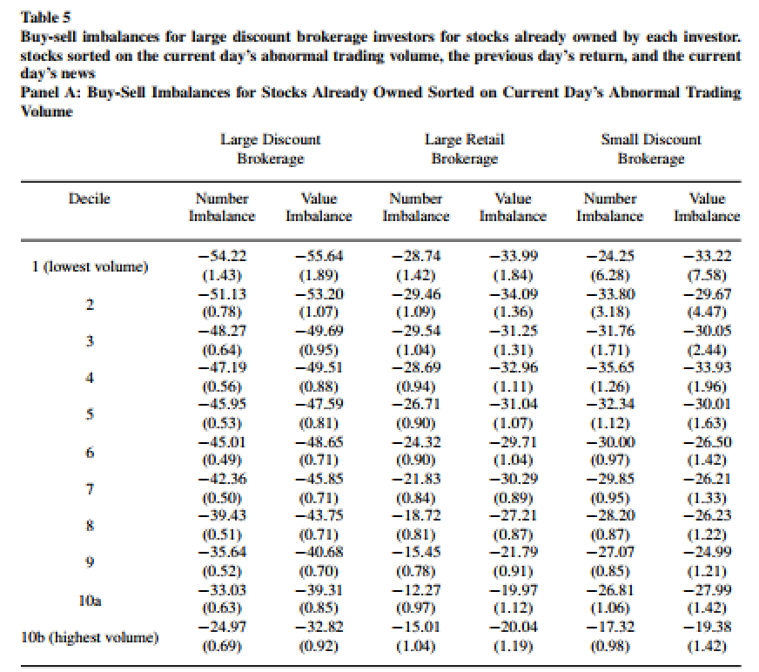
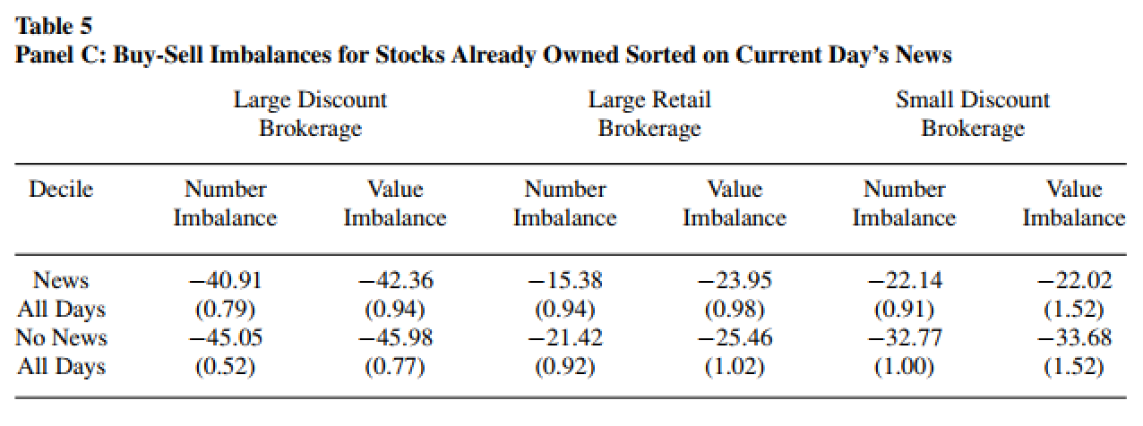
2. Short-Sale Constraints

Slide 17
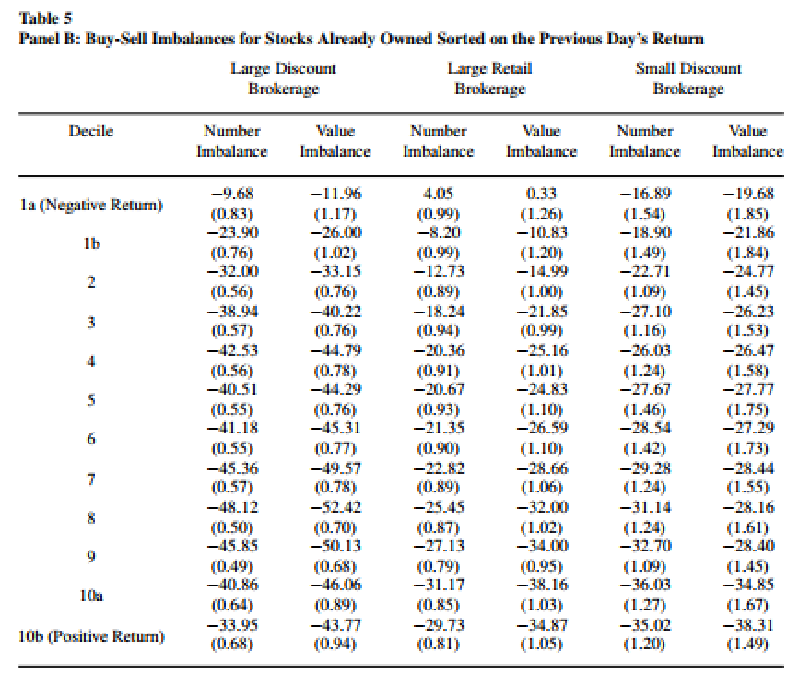
2. Short-Sale Constraints

Slide 18
Conclusion
This paper shows that individual investors are net buyers of attention-grabbing stocks, e.g., stocks experiencing high abnormal trading volume, stocks with extreme one-day returns, and stocks in the news.
Attention-driven buying results from the difficulty that investors have searching the thousands of stocks they can potentially buy
Individual investors do not face the same search problem when selling because they tend to sell only stocks they already own.
1
2
3

Slide 19
Discussion 1. Main Variable (Buy-Sell Imbalance)

Slide 20
Discussion
2. Correlation vs Causality
“Attention-driven buying”

Slide 21
Discussion
2. Endogeneity Issue & OLS regression
Ex. Extreme return rate increases Buy-Sell Imbalances
Ex. Abnormal Volume increases Buy-Sell Imbalances
Ex. Being on news increases Buy-Sell Imbalances

Slide 22
Any Question or Comment?
Thanks for listening
Notes:
슬라이드 쇼 모드에서 화살표를 선택하여 링크를 방문하세요.

